Slide 1

Resource Management and Scheduling in Distributed Stream Processing Systems: A Taxonomy, Review, and Future Directions By XUNYUN LIU, RAJKUMAR BUYYA
Group Presentation
Course Name: Distributed Computing System (CSE707)
Submitted to
Annajiat Alim Rasel
Senior Lecturer, Department of Computer Science & Engineering
BRAC University
Submitted by
Shiva Bahadur Pathak -21166052
Suvro Debnath-21266011

Slide 2
Introduction
What is Stream Processing ?
Computing, analyzing, storing data as it is produced or received
Distributed Stream Processing System(DSPSs)
E.g. Apache Flink, Apache Strom
Resource Management
Task Scheduling
Service Level Agreement (SLA) & Cost Constraints
Could Computing
Challenges/Problems
Deployment of Streaming system
Quality of Services(QoS)
Maintain Resource cost
Manage resources
Manage Task

Slide 3
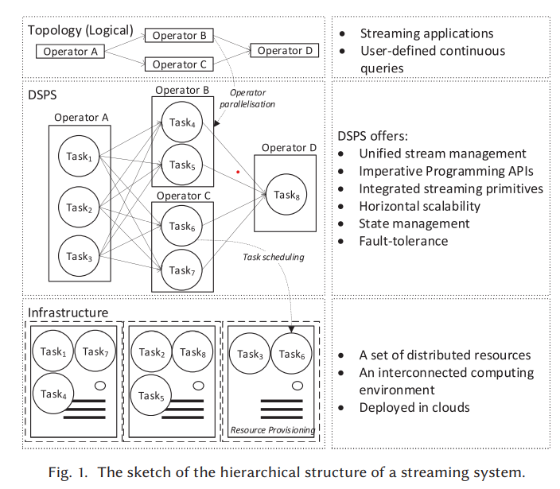
Introduction(continue…)
Directed Acyclic Graph
Data Parallel and Pipelined
Replicas knows as task
E.g. Silicus, google dataflow etc.
Resources Provisioning
Estimate, select and allocate appropriate resources
Operator Parallelism
Divides a parallel operator into several functionality equivalent replicas
Task Scheduling
Maps streaming to horizontal/vertical scaled resources

Slide 4
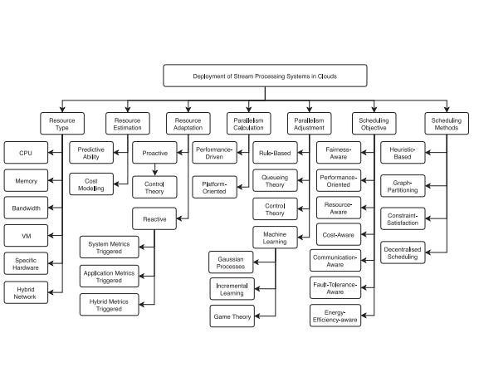
Related Works
Merge result of stream processing model and complex event processing model.
Fault tolerance and comparison among different DSPSs implementation
Optimization to improve the performance stream processing system
A general data stream processing covering both system and uses. So on
fig. 2. The taxonomy of resource management and scheduling in distributed stream processing systems.

Slide 5
Resources
Resource Adaptation
The adaptation of resource allocation to the changes of workload volume and application performance.
Proactive Adaptation
Reactive Adaptation
Resource Type
Various resource types involved in the resource management process to compose the stream processing infrastructure.
Resource Abstractions
Virtual Machines
Specific Hardware
Hybrid Network
Resource Estimation
The estimation and modelling of resource costs for a streaming system to satisfy its SLA requirements.
Predictive Ability
Resource Cost Modelling

Slide 6
PARALLELISM
PARALLELISM CALCULATION
Performance-driven Parallelization
Platform-oriented Parallelization
PARALLELISM ADJUSTMENT
Rule-based Approaches
Queueing Theory
Control Theory
Machine Learning and Game Theory

Slide 7
SCHEDULING
SCHEDULING OBJECTIVES
SCHEDULING METHODS
Fairness-aware Scheduling
Performance-oriented Scheduling
Resource-aware Scheduling
Cost-aware Scheduling
Communication-aware Scheduling
Fault-tolerant Scheduling
Energy-efficient Scheduling
Heuristic-based Scheduling
Graph-Partitioning-based Scheduling
Constraint-Satisfaction-based Scheduling
Decentralised Scheduling

Slide 8
GAP ANALYSIS AND FUTURE DIRECTIONS
Fine-grained Profiling
Straggler Mitigation
Transparent State Management
Resource-availability-aware Scheduling
Energy-efficient Scheduling
Cost Efficiency with Different Pricing Models
Container-based Deployment
Integration of Different DSPSs

Slide 9
Thank You ☺

